Slide 1
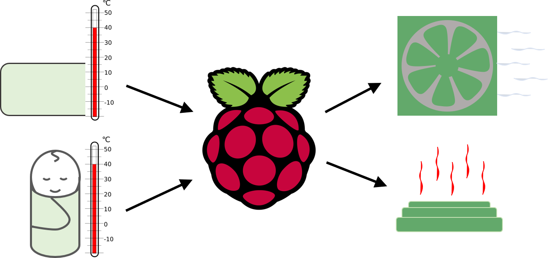
FINAL DEVICE
Heating Element
Fan
Temperature Sensors
Modular Enclosures

